Slide 1
U of R Buy & Sell
CS476 Final Project
Ibrahim Adogba | Wilbur Dulce | James Sieben

Slide 2
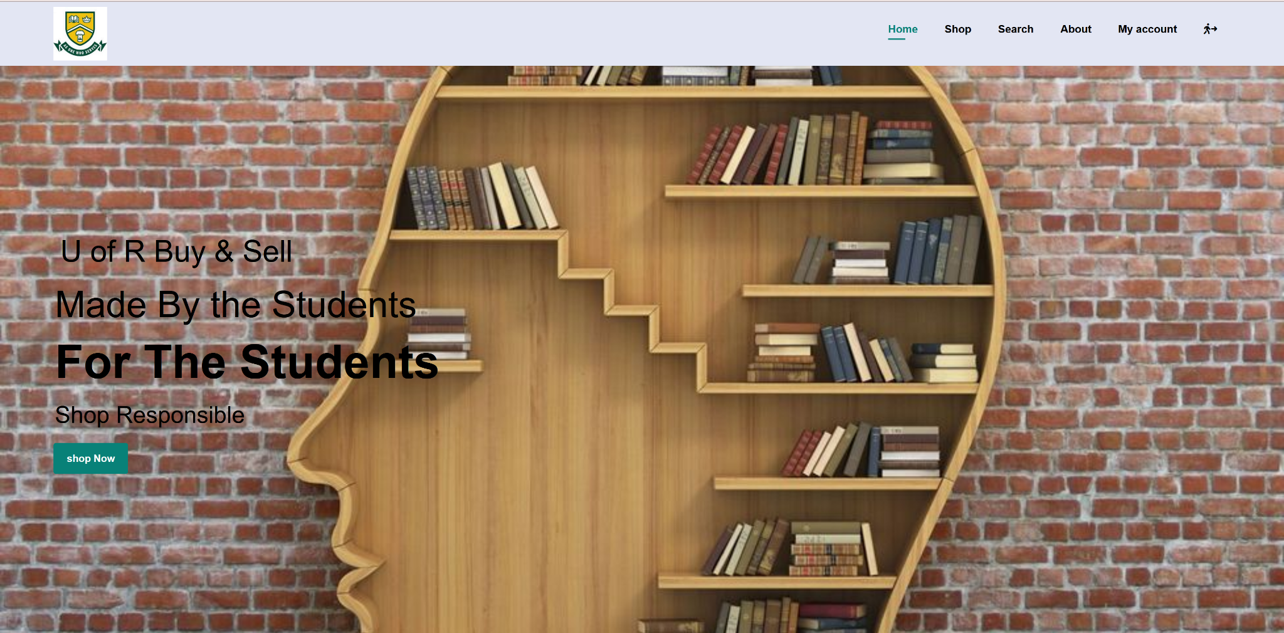
Purpose and Goals
The purpose of our project is to create a space where students can directly buy and sell textbooks from each other
Our Buy & Sell website makes it easy for U of R students to upload their old textbooks and connect with other students
In contrast with Facebook marketplace or Kijiji, our site only allows books and is only open to U of R students
Unlike the school bookstore, books of any quality can be posted and there is no additional markup

Slide 3
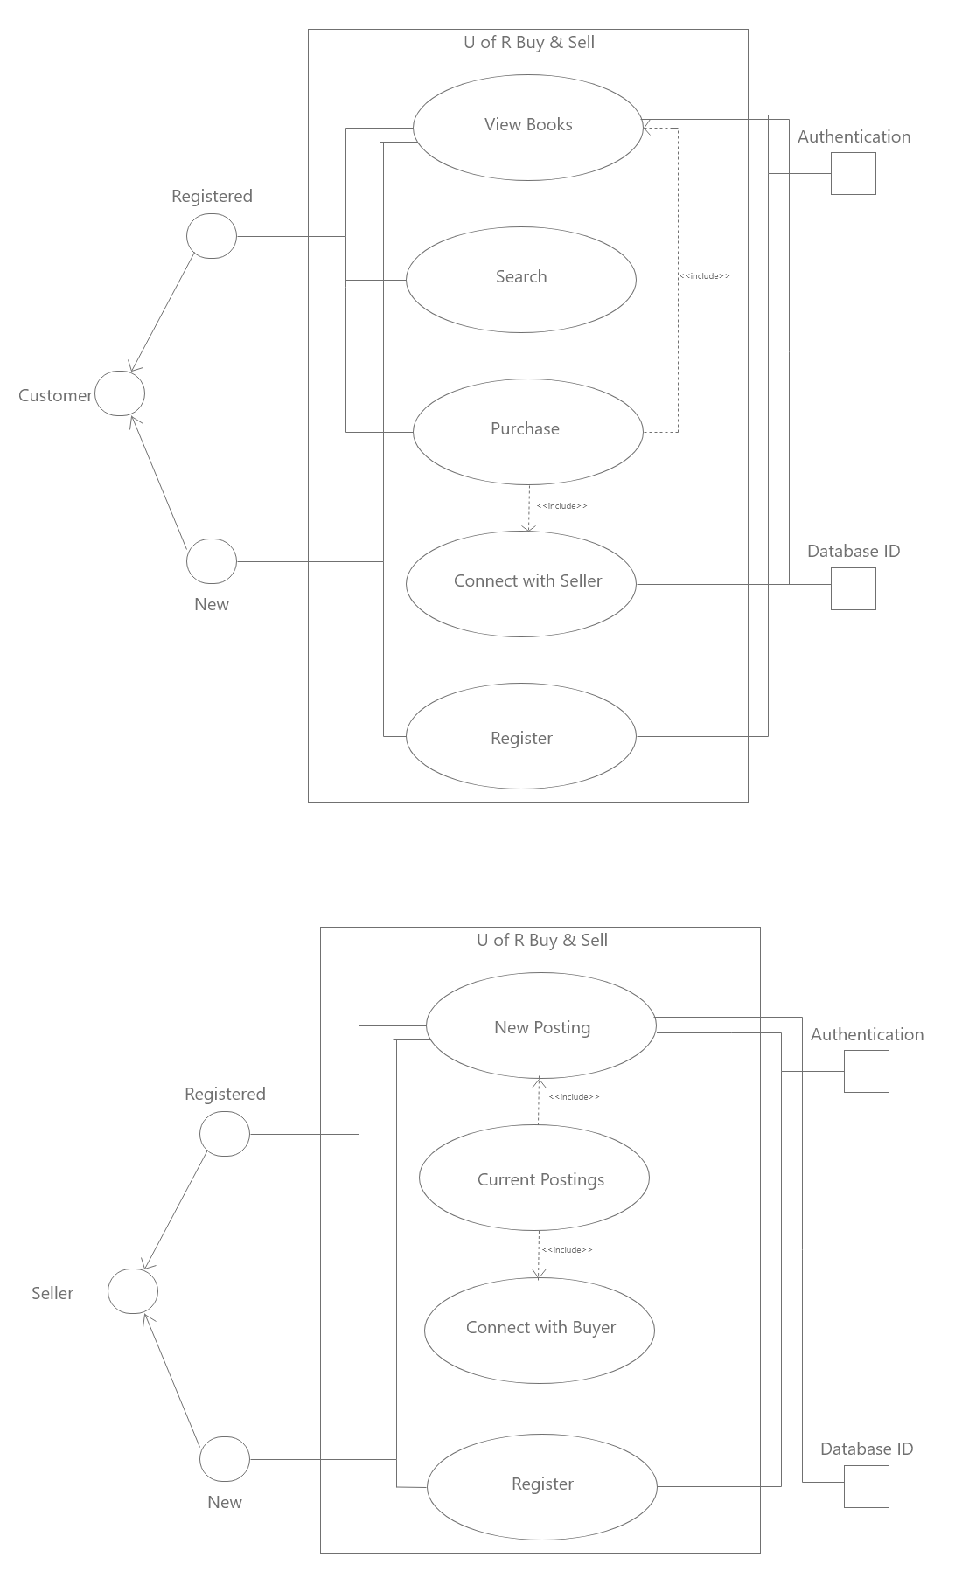
Use Case: Seller
Sellers must sign up before using our site and must be registered U of R students
Registered users are asked to login before viewing the site
Sellers may:
Create a new post
View their current postings
Connect with potential buyers through their student email

Slide 4
Use Case: Buyer
Similarly, students shopping for books must login before viewing the site
Users may:
View a specific listing
Search the site for books by title, author, genre, or ISBN
Purchase books by connecting with sellers
To buy a book, the user will be shown the seller’s email so that they may directly communicate

Slide 5
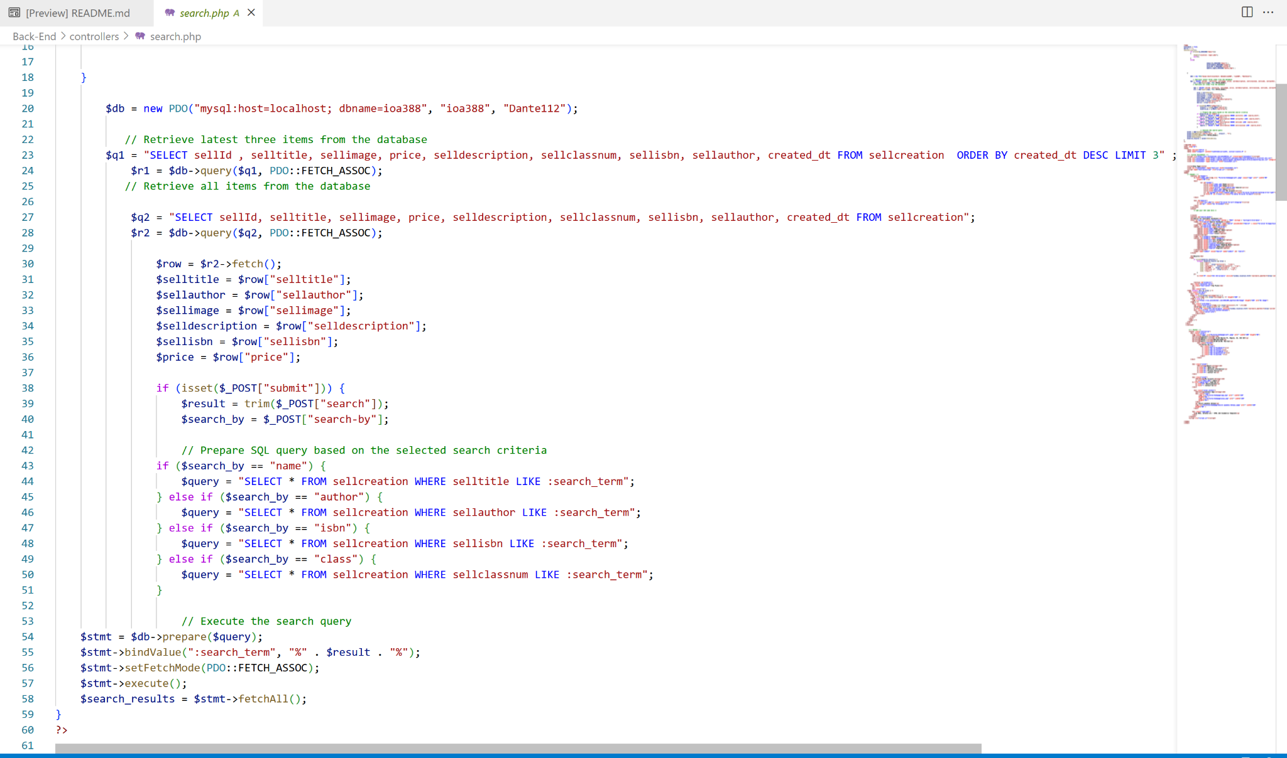
MVC: Controller
The Controller is responsible for processing input and directing data flow
In our web app, it handles requests to view books, upload books, and communicate with other users, as well as managing the database to store and organise user and book information
Ex. If a book is bought, the Controller removes it from the database and updates the View so that book isn’t shown anymore
The screenshot shows the code to search the Model and returns results to the View

Slide 6
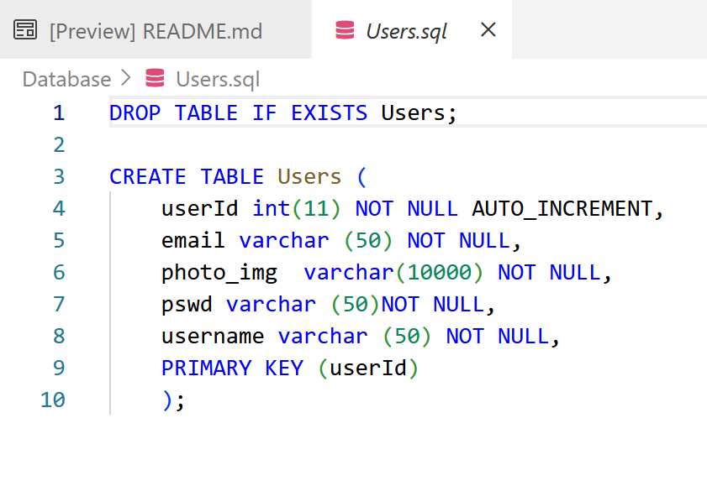
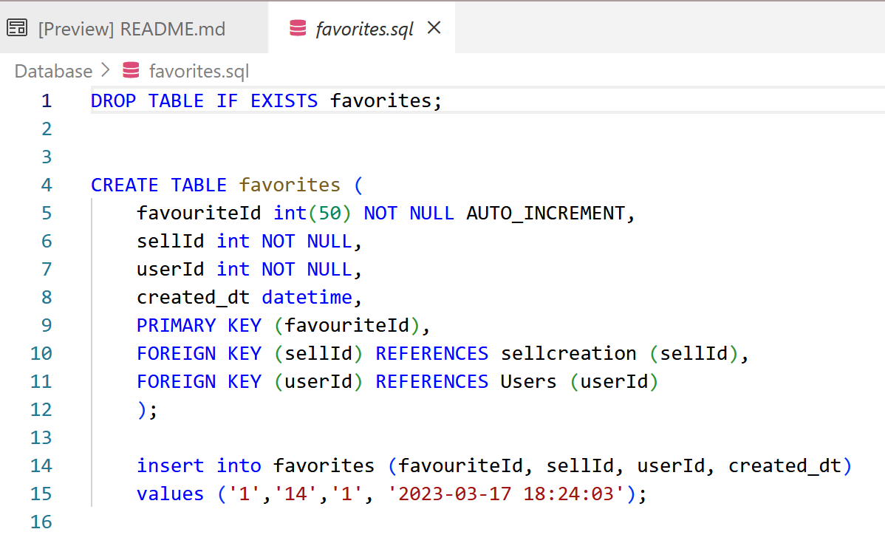
MVC: Model
The Model is the data layer, it’s responsible for storing, retrieving, and manipulating the data stored in the database
For our use, it stores info about books and users, such as the book titles, authors, descriptions, and usernames, emails, and addresses
Our site uses MySQL and JSON requests
The code shown creates the Users table and the favorites table within the Model

Slide 7
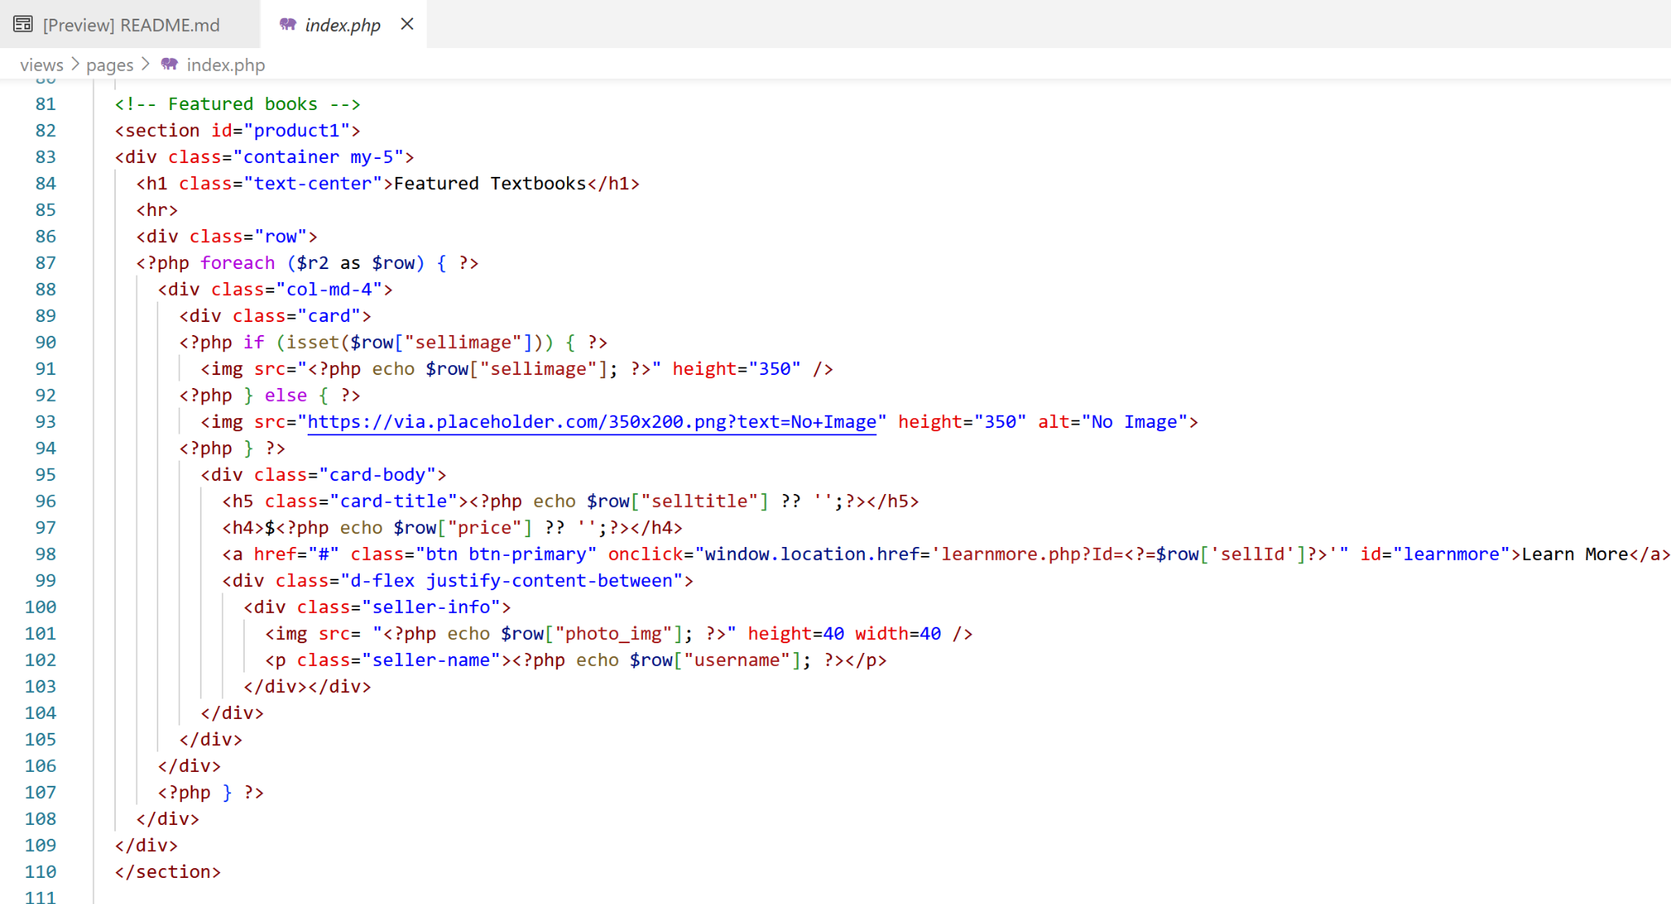
MVC: View
The View is the user interface of the app
We used HTML, PHP, and CSS to display our website to users
Updated by the Controller so if a book is uploaded or deleted the View will display the correct info
This code displays the featured books on the homepage - it relies on the Controller to pull titles and images from the Model

Slide 8
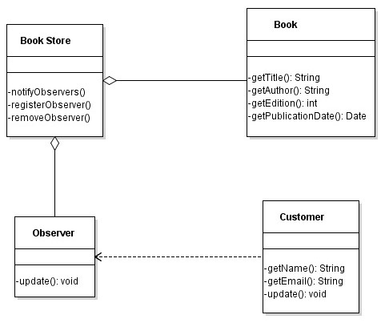
Design Pattern: Observer
The observer design pattern is focused on the interactivity of the site
User’s are assigned “Observers” which notify them of state changes
For sellers, an Observer notifies them if a user has added their book to the user’s favourites list
For buyers, an Observer notifies them if a book in their favourites has been sold or if a book they want has become available

Slide 9
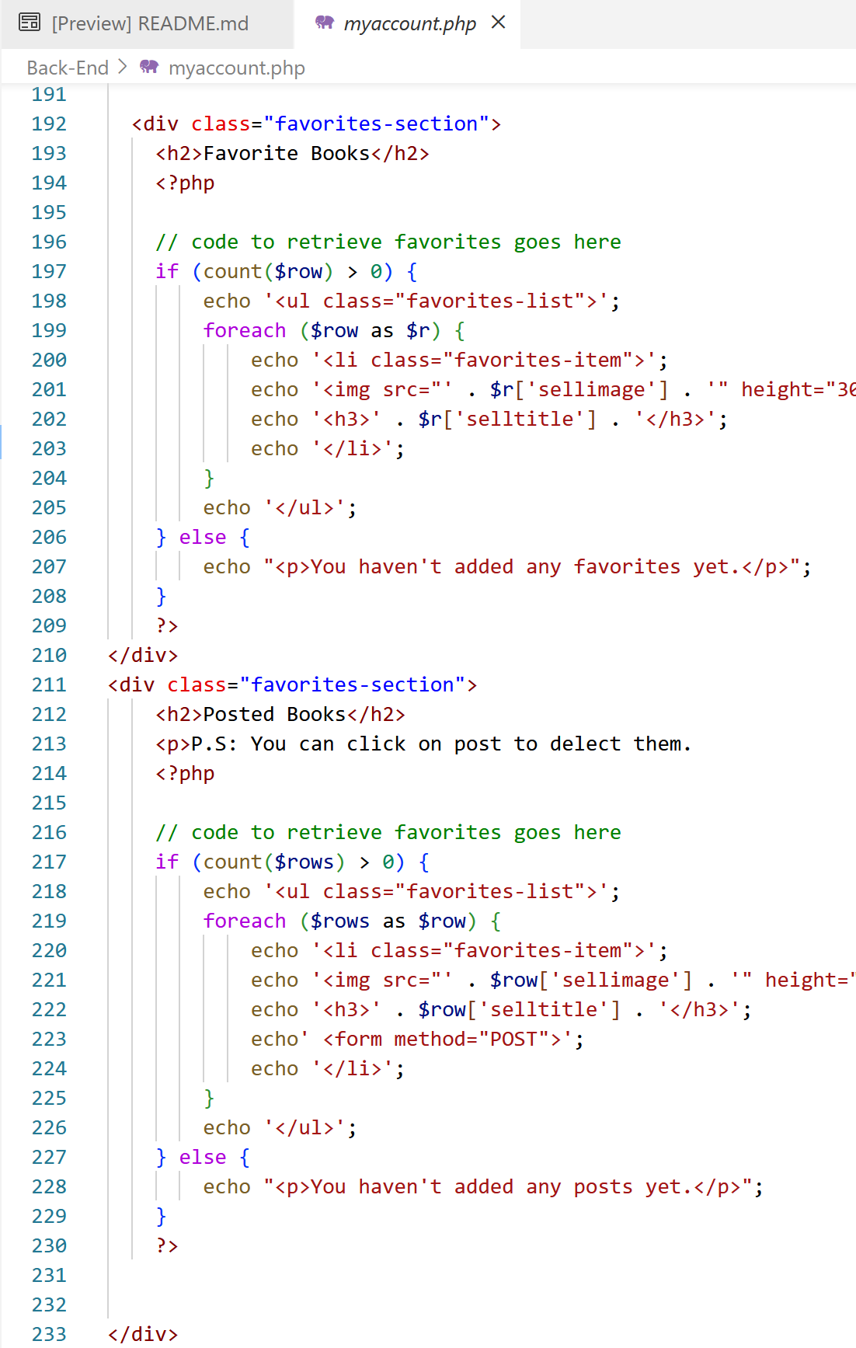
Design Pattern: Observer Cont.
Implementation of this design pattern was limited due to complexity and time constraints
At the moment, user’s can add books to a favourites list or upload new posts but they will not be notified if any state change occurs
The code shown pulls the user’s favourite books from the database to be displayed. Ideally, an Observer would be here to occasionally check for changes and notify the user if there is

Slide 10
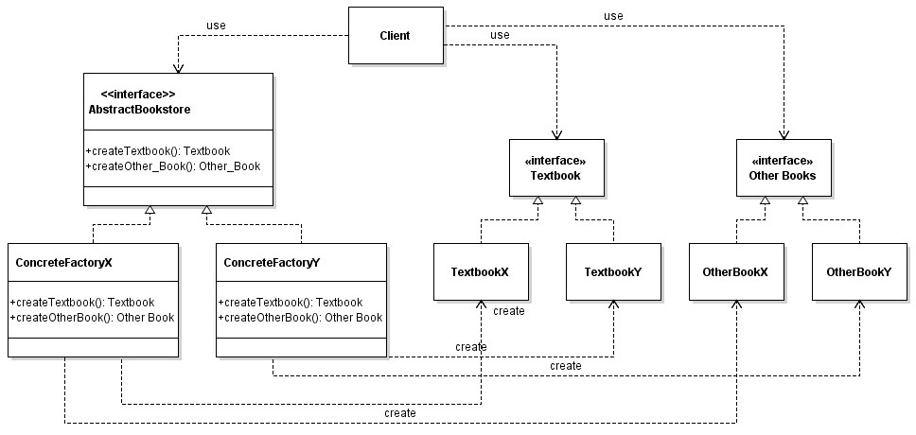
Design Pattern: Factory
Makes creating or deleting book objects simpler and keeps code organised
Similar for adding users to the database
A book can be uploaded by normal users or by administrators - then the create function is called and a new book object is created with info like the title, author, and ISBN
The client is only able to see the interfaces for the bookstore and books

Slide 11
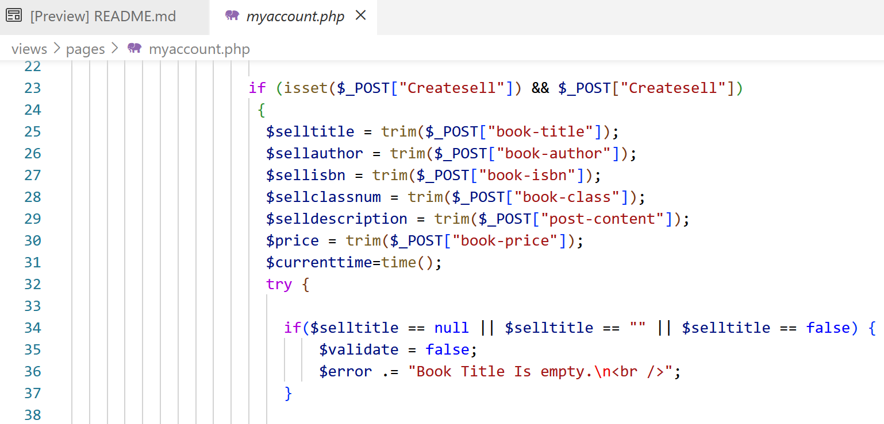
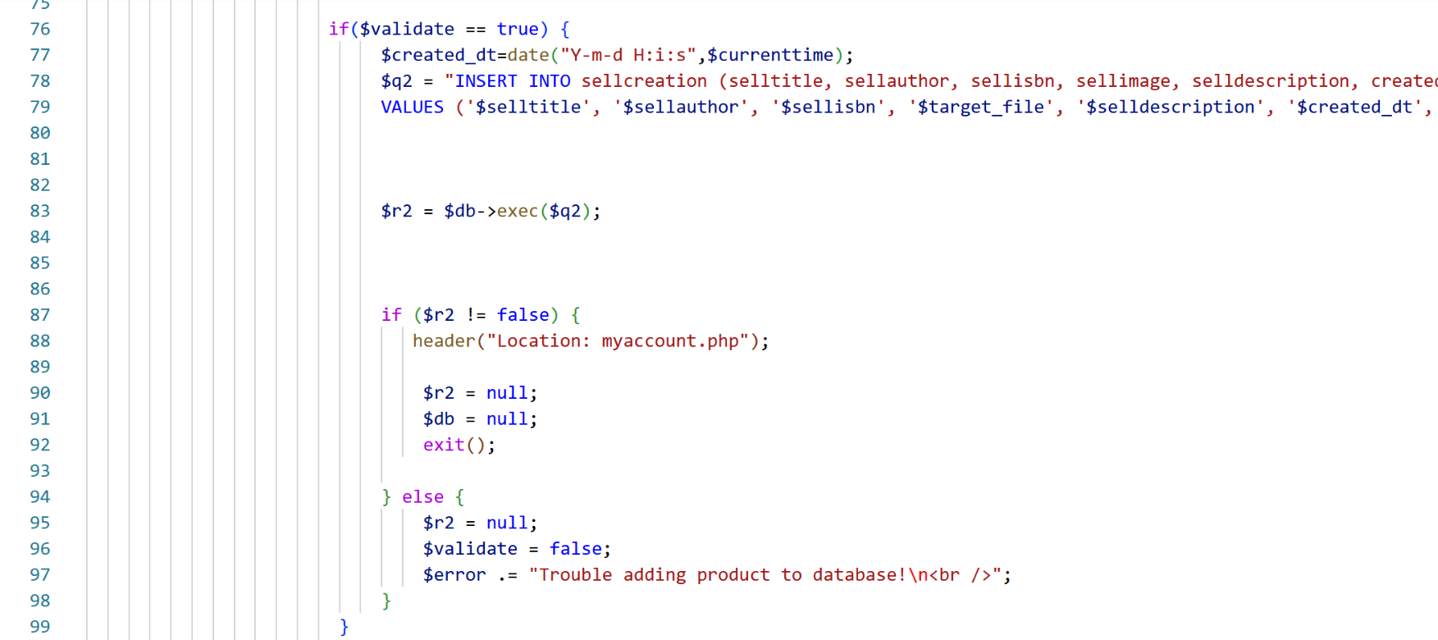
Design Pattern: Factory Cont.
Sellers can be thought of as the factories creating new books by making new posts
Buyers only interact with the View which uses the Controller to display the bookstore website and books
The code shown takes user-entered info to make a new post and saves it in the database - this can be thought of as the create function in the factory

Slide 12
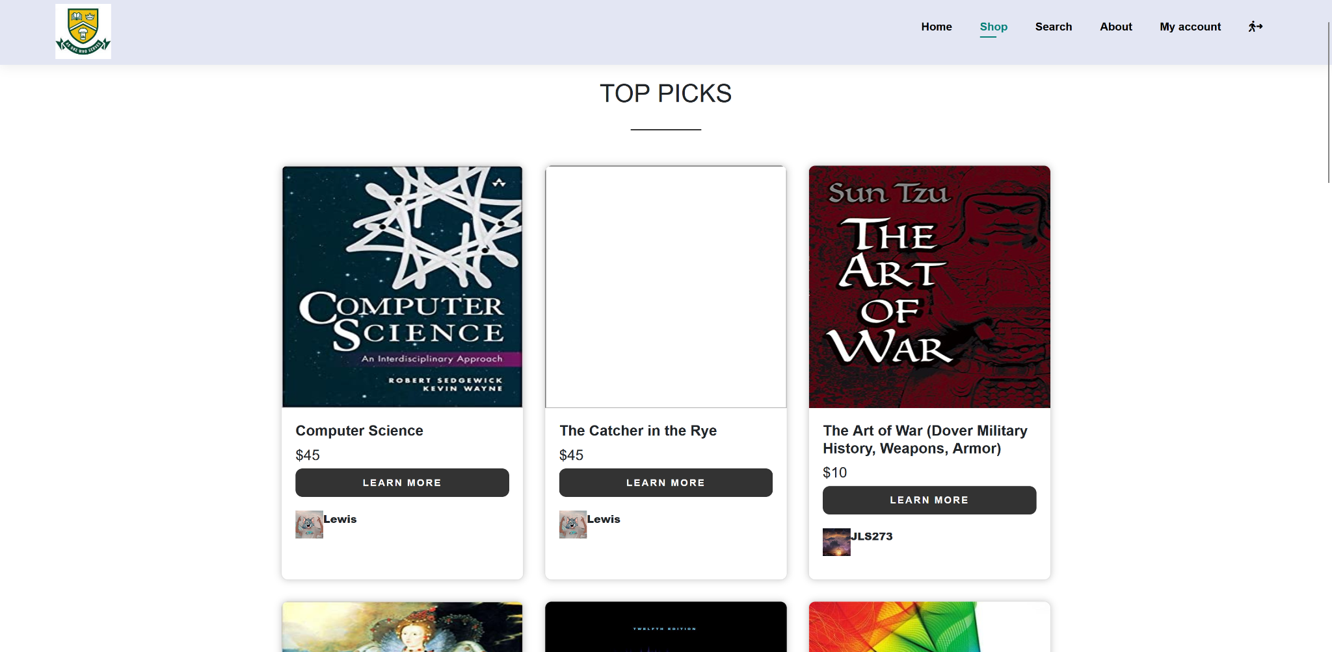
Software Behaviour
The site functions in a similar way to Kijiji or Facebook marketplace
Sellers upload their own books to sell and buyers browse books and message sellers directly
Transactions do not take place on our website, instead users are expected to work out payment methods and book exchanges themselves after connecting through our site
The site allows users to search, view top picks, view a specific book, add a book to favourites, and upload

Slide 13
Thanks!

